Slide 1
Pilot Data
Saliva & Subgingival Microbiome

Slide 2
Samples
DNEasy Blood & Tissue (DBT)
PowerFecal Pro (PF)
DNEasy Blood & Tissue (DBT)
PowerFecal Pro (PF)
Saliva
Subginvgival

Slide 3
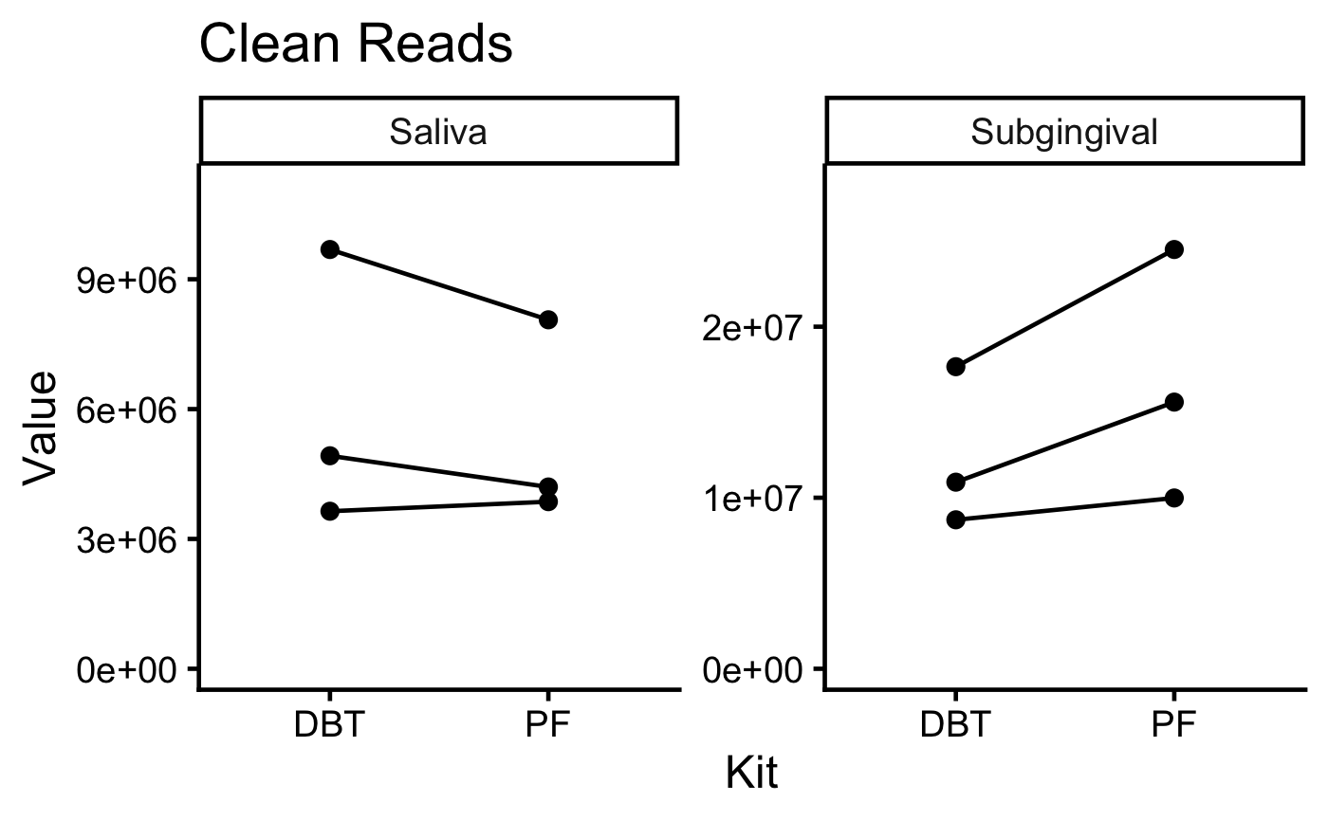
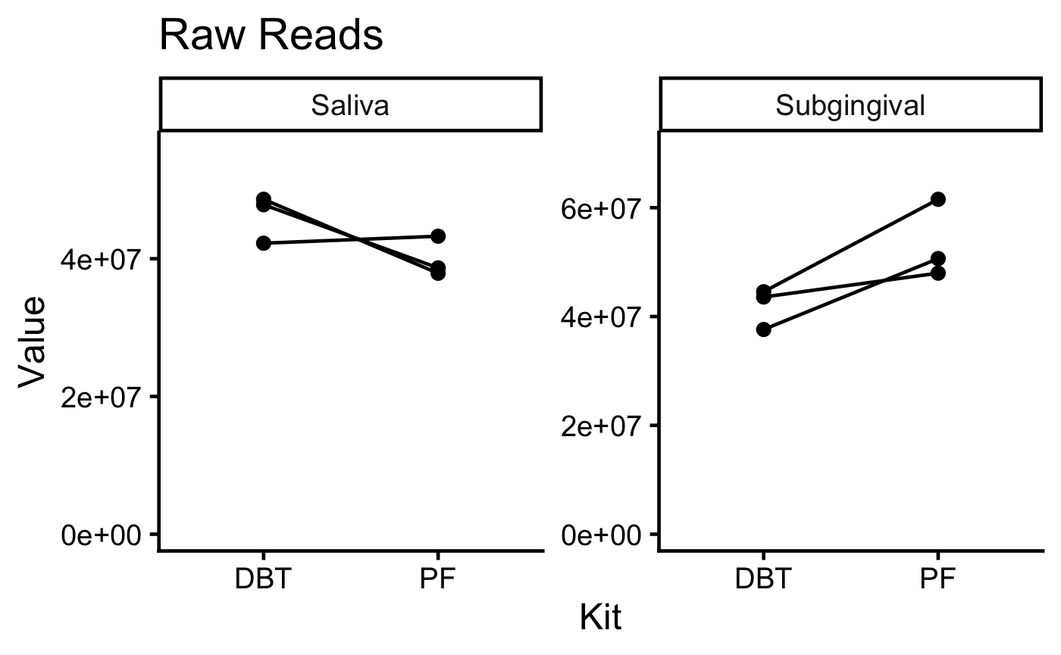
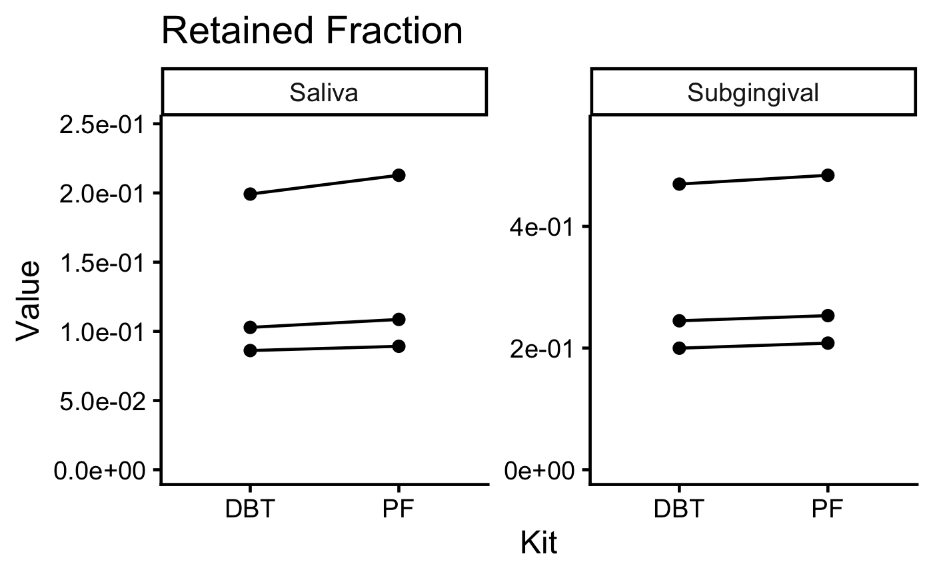
Both kits produce an equivalent number of usable reads.
*
*
Paired T tests. Retained fraction = Clean/Raw.
(Yes, it’s weird that the subgingival retained fraction is the only significant test, but I triple checked)

Slide 4
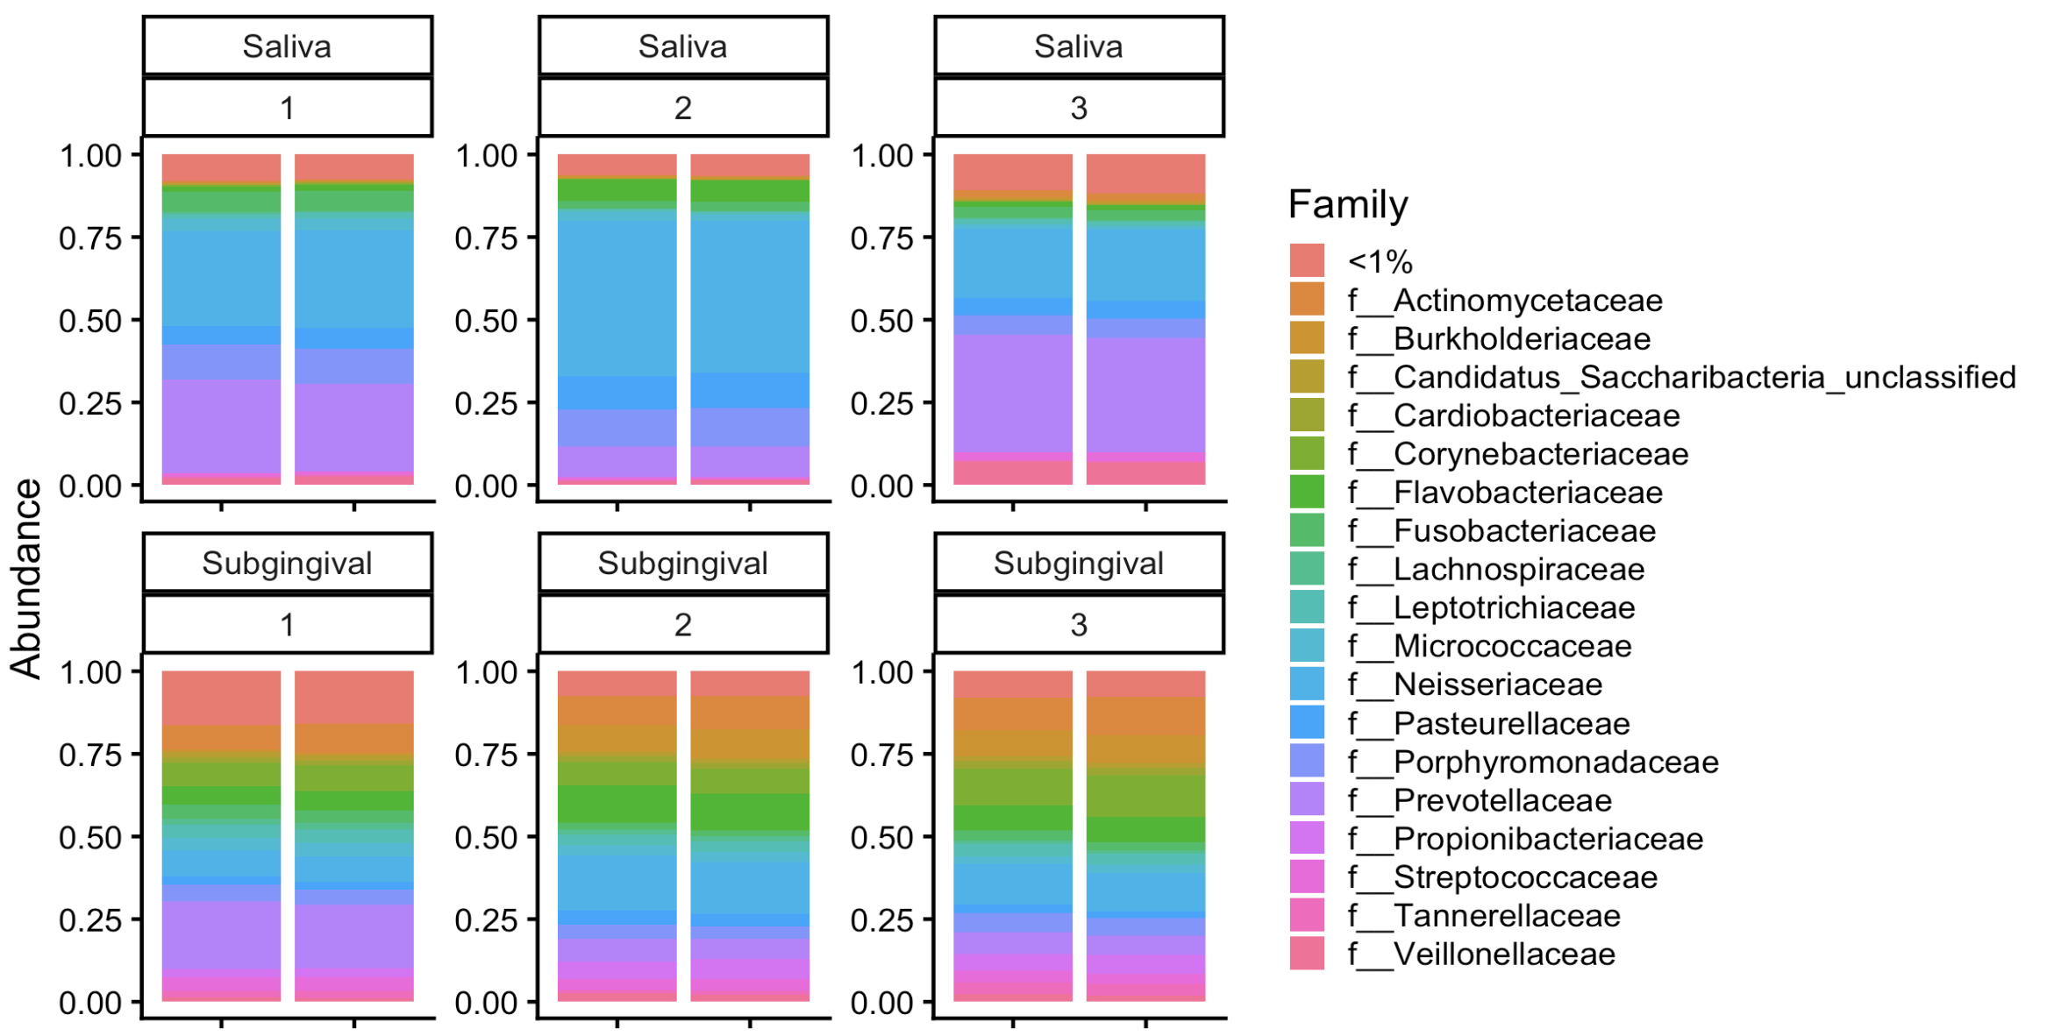
No major differences in taxonomic composition.
Sample number

Slide 5
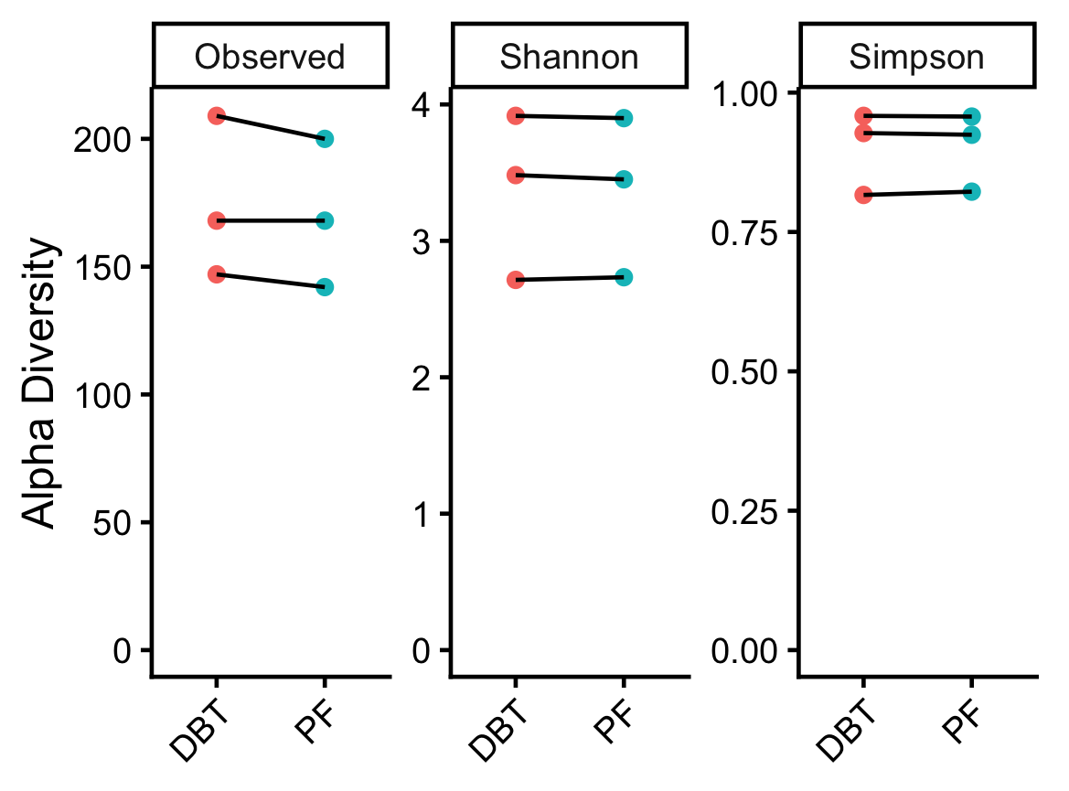
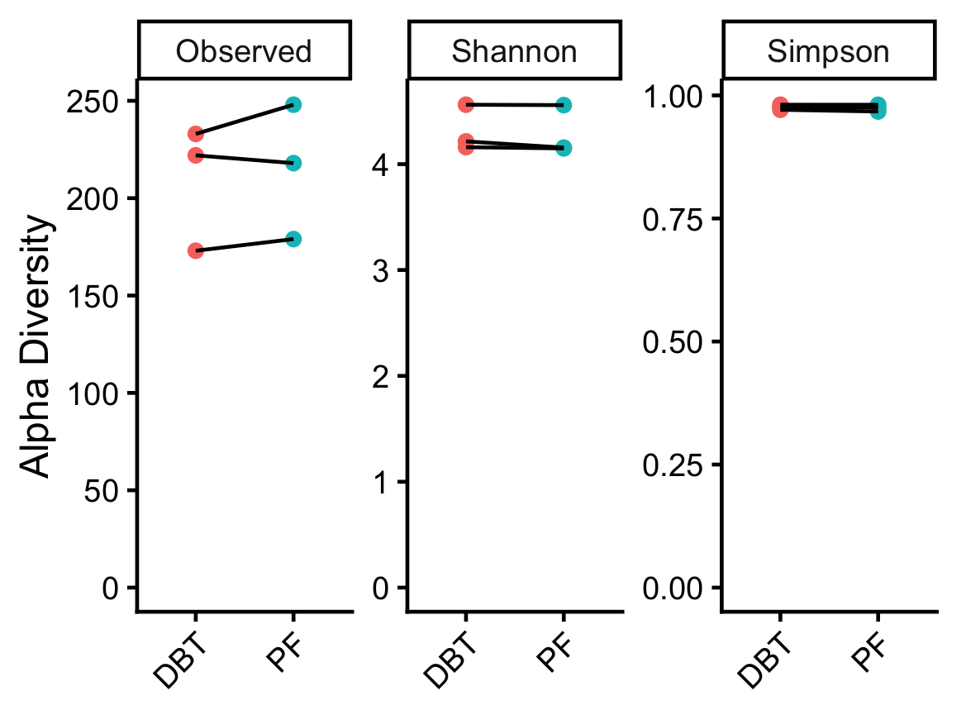
No differences in alpha diversity between kits.
Saliva
Subgingival
Paired T tests. All P > 0.05.

Slide 6
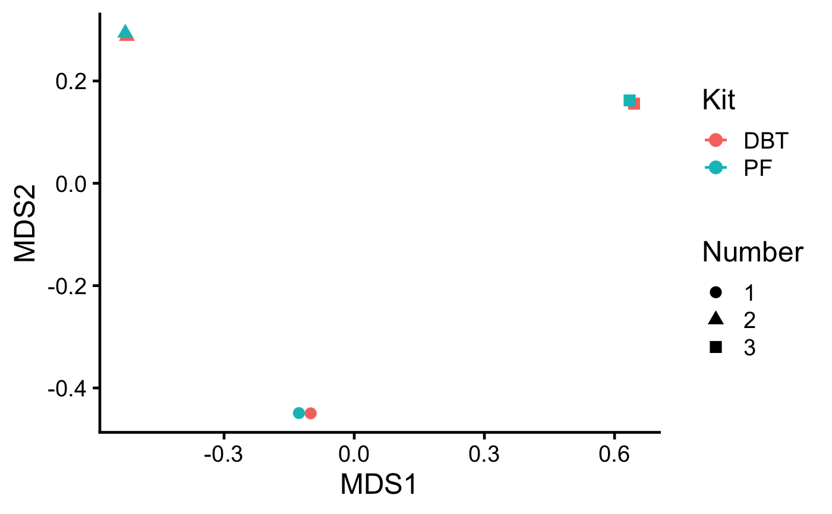
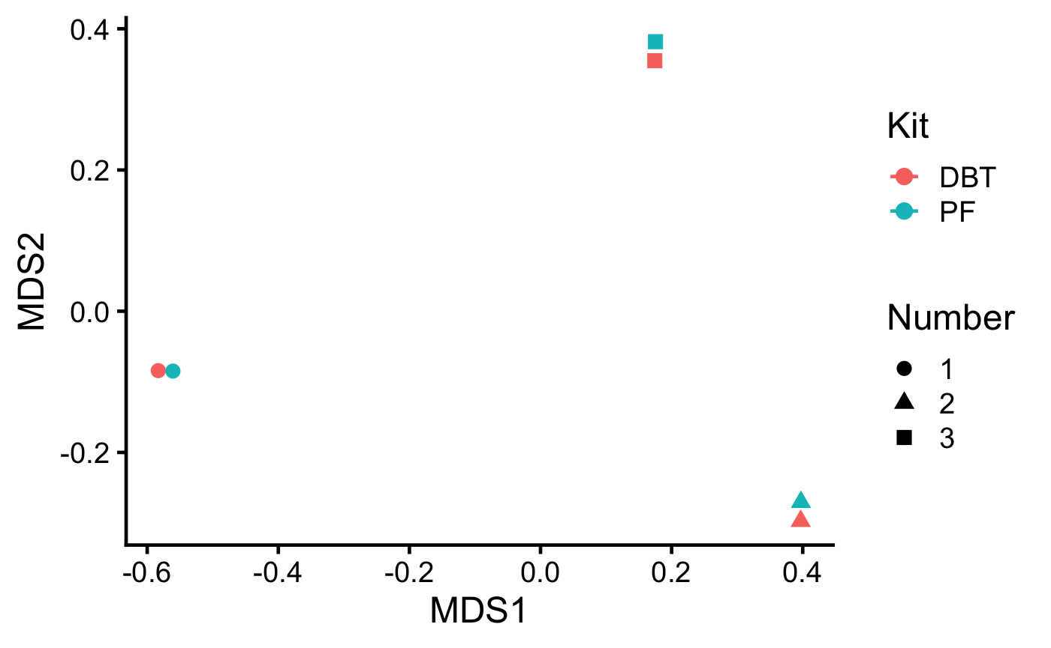
No differences in beta diversity between kits.
Saliva
Subgingival
Bray-Curtis metric, PERMANOVA tests. All P > 0.05.

